Slide 1
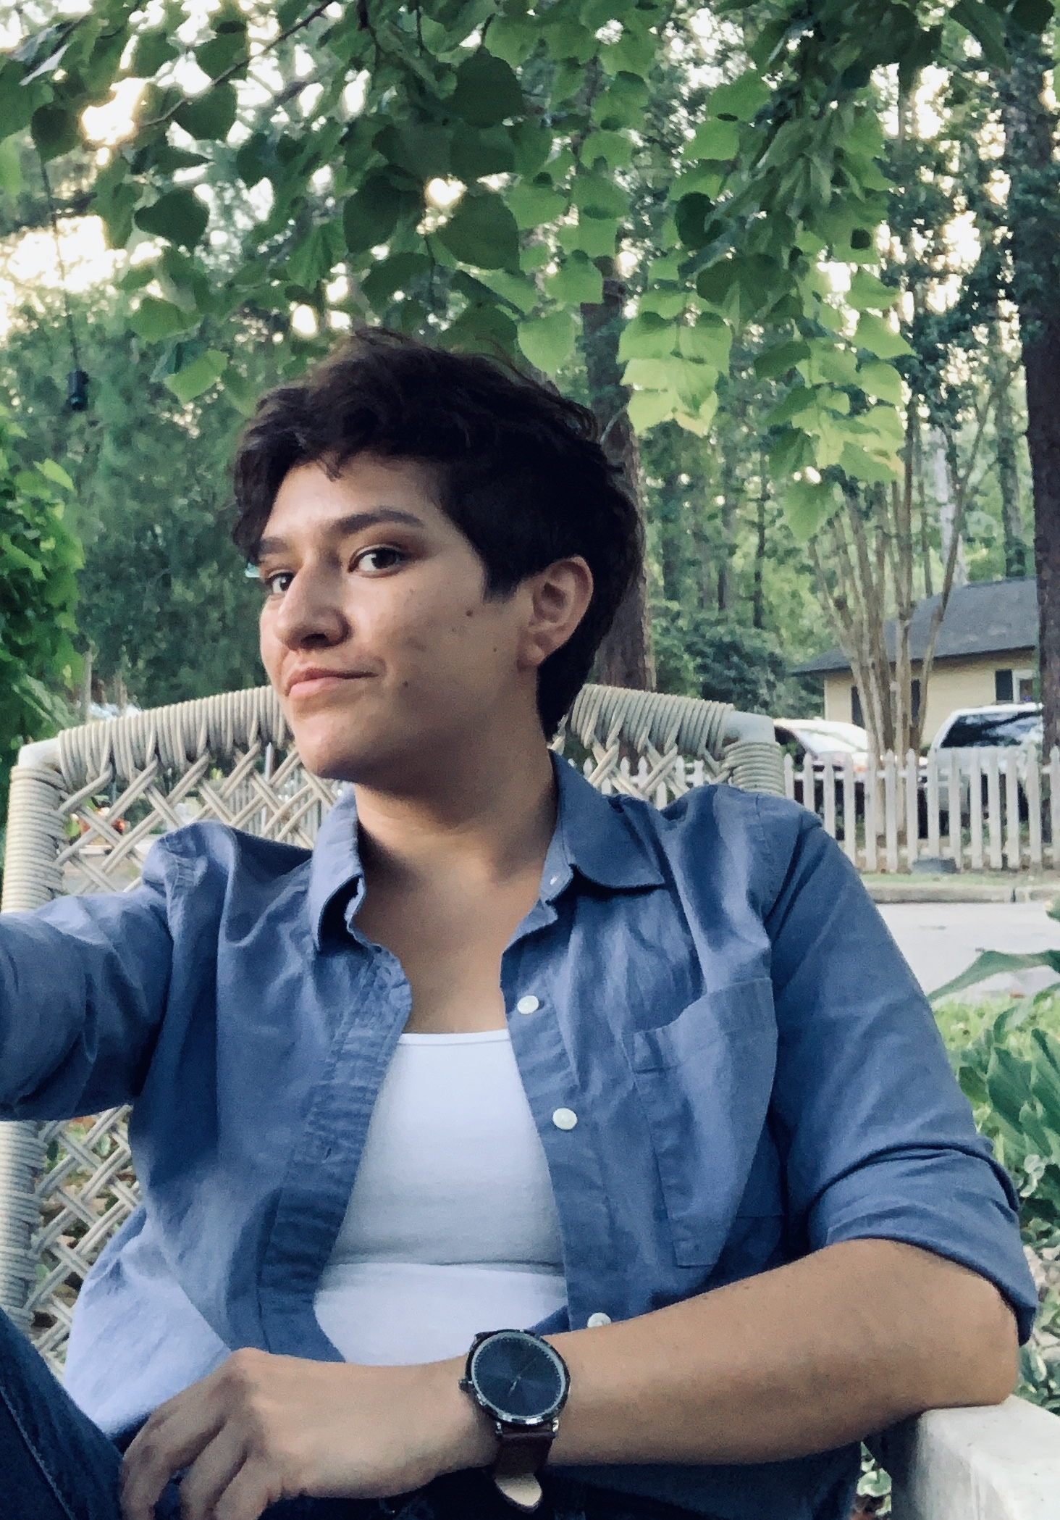
Mary Twyman
I was raised in Tallahassee, Fl, with my parents and two sisters. I grew up exploring life through a very curious lens. From observing critters under the ground, to climbing high in the trees for a better look at my surroundings, I observed and questioned everything. I love working with children because they are not afraid to ask “why.” They are curious about the world around them, and I try to answer their questions through exploration and insightful conversations.
I later went on to attend Flagler College for a Bachelor of the Arts degree in Elementary Education. I had the pleasure of interning at Kate Sullivan, and began working in second grade shortly after receiving my degree. This will be my third instructional year with Kate Sullivan, and I am so excited to see what it has in store. This digital platform may be new and somewhat uncharted, but its nothing a little curiosity and exploration can’t handle.

